Slide 1
Managing Your Project Using Software Engineering Process
CPT202 Software Engineering Group Project 2024/2025
Soon Phei Tin

Slide 2
Topics
Exploring the projects in this module
Understanding Scrum in action
Get ready for the Cardboard game

Slide 3
Exploring 3 Projects
To be available

Slide 4
Initial Requirements Study - Understand Your Project -
Problem statement
A problem statement is a concise description of an issue to be addressed or a condition to be improved upon.
It identifies the gap between the current state and desired state of a process or product.
The process of defining the problem is often a group effort. It starts with meeting with the stakeholders, customers, and/or users affected by the issue (if possible) and learning about their pain points.

Slide 5
Aims of the project
What the project is set to achieve? What problems to resolve?
Time frame?
Phases?

Slide 6
Project Scope
What does and doesn’t lie within the project
E.g. The project track the status of order delivery. However, the actual delivery of the order is to be done by third party and hence is outside of the control of the system.
Represent the scope using use-case diagram

Slide 7
User Characteristics
List the users involved in the system.
If they are organizational users, get the organizational chart.
Understand the political influences of the users.
List the characteristics of the end users that may influence UI/UX design.
Regional and cultural background
Age and ability in the system operation

Slide 8
Constraints
Compatibility with existing internal/external system?
Availability of the technologies?
Environmental (e.g. pandemic)?
Financial budget?
Time constraint?

Slide 9
Assumption and Dependencies
Assumption:
things that are accepted as true or as certain to happen, without proof.
the events or conditions that are most likely to occur when a project life-cycle takes place.
Examples:
All the resources (equipment, tools, or materials) will be in good condition to be used throughout the project life-cycle.
The total cost of daily operations will remain unchanged.
All relevant stakeholders will come to the next meeting as scheduled.
All the physical devices such as laptops, computers, mobile phones, printers, and more are in good condition to be used when conducting the project.

Slide 10
Assumption and Dependencies
Dependencies:
A dependency in project refers to a series of tasks that are interrelated.
Types of dependency
Finish-to-Start: Task B cannot start until task A has been completed
Start-to-Start: Task B cannot start until task A starts
Finish-to-Finish: Task A cannot be completed until task B is completed
Start-to-Finish: Task B cannot be completed until task A starts
Examples:
There is an old website running life, but you want to replace the old one with the new one, you will retain the old website unless the new one is completed.
The configuration of server cannot be started before the completion of a training.

Slide 11
Research Task
How to manage and reduce risks of your assumption and dependencies?

Slide 12
Scrum Framework

Slide 13
Software Requirements
Epics > Features > Product Backlog Items > Tasks
Epic is a larger scope of requirement which can be divided into smaller requirements
An Epic can be spread across sprints and even across agile teams
An Epic can be a high-level description of what the client wants
Epics also allow teams to give high-level understanding of their work to stakeholders without getting into technical details.

Slide 14
Epic
Examples:
As a customer, I want to shop online so that I can purchase books from the online book store.
As a store manager, I want to manage the store’s overall operation so that the store operation is smooth and the customer is satisfying with the service.
As an administrator, I want to maintain the book store website so that the store is secure and reliable.
All epics must be in a SLAP
Single Level of Abstraction Principles

Slide 15
Epic >> Features
Epic: As a customer, I want to shop online so that I can purchase books from the online book store.
Features:
As a customer, I want to have wish lists so that I can come back to buy products later.
As a customer, I want to check my order status so that I know the delivery progress of my order.
etc

Slide 16
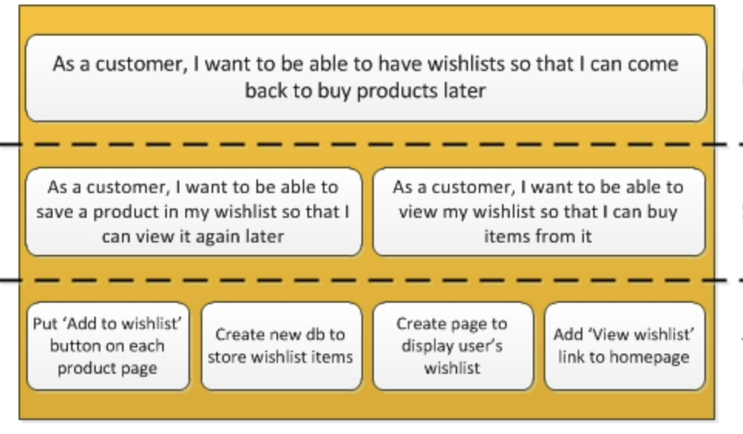
Feature > PBI > Tasks
Feature - A requirement that the business wants. It represent of one the features broken down from an Epic.
Product Backlog Item - A detail requirement that we further defined from the Feature. It is something that is deliverable within a single sprint.
Tasks - Steps need to be taken in order to fulfill the requirement stated in the PBI.

Slide 17
Sample Software Requirements
E-Commerce Platform:
This is a large project and hence you may want to define multiple epics.
The PBIs were ignore for simplicity.
To-Do List project:
It is a small project, we do not need to define epic.

Slide 18
Product Backlog

Slide 19
What is a Product Backlog?
Product Owner is the one responsible to create all the Epics, Features, and PBIs.
They are representing software requirements at different level of abstraction.
They are all organized and stored as a collection we called Product Backlog.
In this project, for educational purposes, we do not require the Product Owner. All team members are responsible to work collectively.

Slide 20
What is a PBI?
A PBI is consisting of: -
PBI ID
Priority
Effort
Title
Story
Acceptance Criteria
Grooming Information
Some organization includes the following: -
Discussion
Related PBI

Slide 21
How Big a PBI Should Be?
Refers to To-Do List project.
Small enough to be completed within a Sprint.
A Sprint usually consisting of multiple PBIs.
Small and simple to understand and implements.
Consisting of single purpose.

Slide 22
Features and PBIs – Bad Examples
As a customer, I want to be able to visit the home page, so that I can see the website information.
As an engineer, I want to design a database table, so that I can add a new book information to the database.
As manager, I want to select some or all of the order contents and click the blue "pick up" button at the top right of the page to cancel the order and send the items to the user to complete the checkout. Managers can also filter orders by pickup location using the drop down menu on the left side of the top. Managers can view all pickup records. The request record will be removed from the list after the pickup.

Slide 23
Acceptance Criteria
Refers to To-Do List project.
Acceptance Criteria are a formal list that fully enumerates user requirements and all the product scenarios put into the account.
It states the intent of the client and not the solution
describe achievable and sensible information
provide the minimum level of functionality the product is to achieve

Slide 24
Acceptance Criteria
Example
User story: As a registered user I want to see the membership expiry date on the billing page so that I know when I have to manually renew or enable auto-renew.
Acceptance Criteria:
The membership expiry date is calculated.
The membership expiry date is displayed.
The date format is yyyy-mm-dd.
Membership details (including expiry date) are not displayed if the user is not registered/authenticated.
Formatted: GIVEN the registered user is authenticated WHEN visiting the billing page THEN the system calculate and display expiry date in yyyy-mm-dd format.

Slide 25
Given-When-Then
(Given) some context
(When) some action is carried out
(Then) a particular set of observable consequences should obtain
An example:
Given my bank account is in credit, and I made no withdrawals recently,
When I attempt to withdraw an amount less than my card’s limit,
Then the withdrawal should be complete without errors or warnings

Slide 26
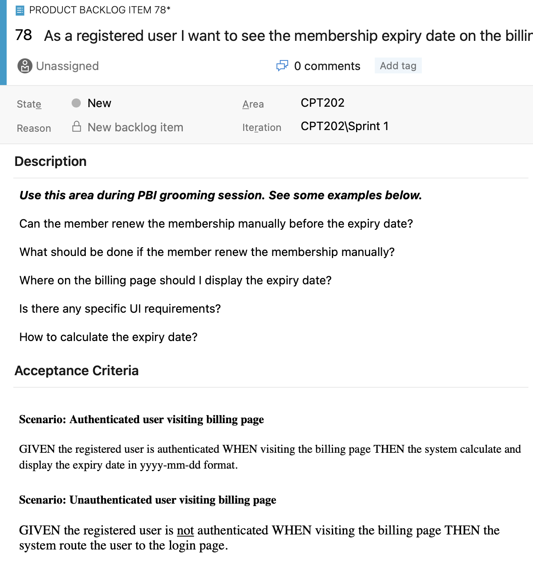
Sample Acceptance Criteria in Azure Board
We can include images to make the PBI clearer
In fact, it is a good practice to include images to help understanding.
In your assignment, try to use images appropriately.

Slide 27
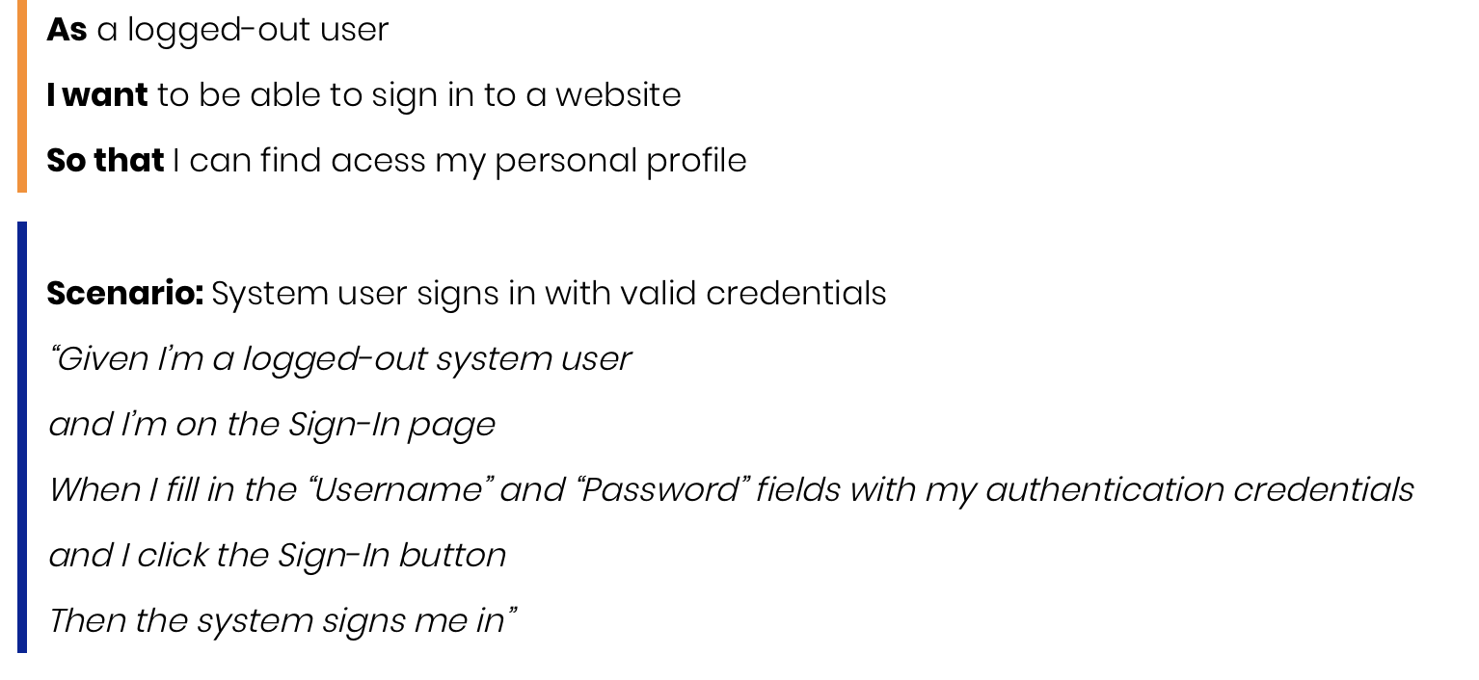
Sample Acceptance Criteria

Slide 28
More Complex Acceptance Criteria
More complex acceptance criteria can be achieved using AND clause
Given-When-Then-AND-When-Then……..
Suitable for actions with consequences for a common context

Slide 29
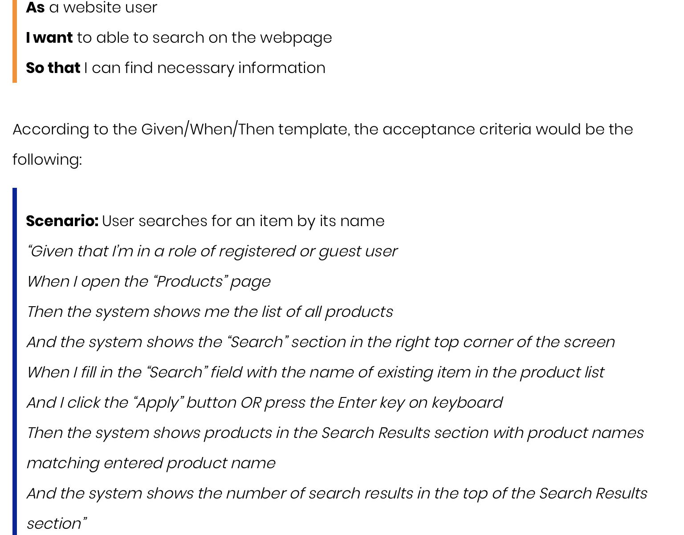
Sample Acceptance Criteria

Slide 30
Important for your project
Your team do not need a Product Owner. All members work collectively as a “Virtual” Product Owner.
When working as Product Owner, you need to set your perspective as one.
As requested in Coursework 1, each member must develop 5 PBIs.

Slide 31
PBI Grooming
PBI Grooming is a process to refine the PBI so that it: -
Covers as much important information as possible.
Is in the right size.
During grooming, we also estimate the effort required to implement it. (You are not required to estimate the effort of your PBI in this project)
Grooming is a team effort.
For Coursework 1, grooming is not required!!!

Slide 32
PBI Grooming
Covers as much important information as possible
Team members raise questions to gain more information that was missed out by the Product Owner.
Raise as many questions as possible to gain enough understanding so that you know what is required to develop.
The Product Owner is responsible to answer all the questions.
The questions and answers has to be recorded as part of the PBIs for future references.
Is in the right size

Slide 33
PBI Grooming
When do you groom?
Before starting Sprint 1: You need to groom enough PBIs with high priority.
During Sprint: Groom enough PBIs for the future Sprint to continue.
DO NOT groom too many PBIs for the Sprints in far future.

Slide 34
Sprint

Slide 35
What is a Sprint?
A Sprint is a time box
Usually 2 weeks. Begin on first workday of week 1, and end on the last workday of week 2.
It may also be a 3-week or a 4-week Sprint.
Consistent throughout the project
Within the 2-week time box, you will do the following: -
Sprint Planning
Sprint Execution
Sprint Review
Sprint Retrospective

Slide 36
What is a Sprint?
Work arrangement for a Sprint in sequence
Begin with a Sprint Planning.
It is a meeting among all team members to produce a Sprint Backlog
It takes less than 3 hours, depending on the experience of the developer and the difficulty of the project.
Follow by Sprint Execution. All team members begin the implementation following the Sprint Backlog.
Sprint Execution start from the 1st day of a Sprint after the Sprint Planning Meeting. Ends at the last day of the Sprint.
Throughout the Sprint Execution, conduct a Daily Scrum (Stand up meeting. It takes about 15 minutes)
Participant in PBI grooming whenever is needed.
Sprint Review
Sprint Retrospective

Slide 37
Sprint Planning

Slide 38
What is Sprint Planning?
Sprint Planning is a meeting among all team members to produce a Sprint Backlog
In practice, the Product Owner will tell the team the overall goal for the current Sprint. For your project, you should discuss and agree among all members. Or the team leader should fix an overall goal.
According to the goal, select the PBIs to be implemented in this current Sprint.
For each PBI to be implemented, discuss and agree on the tasks involve in completing the PBI.
For each task, who will do it? How much time is required?
Record all information on a Sprint Backlog (Refer to the template)

Slide 39
Sprint Review & Sprint Retrospective

Slide 40
Sprint Review
In practice, Sprint Review is a meeting among the development team and the stakeholders to review the result (software product) of the current Sprint.
For your project, you have no actual stakeholders. Therefore, you can review the result among yourselves.
It takes less than 2 hours, depending the on project. In your case, you can complete it within an hour or less.
The meeting start on the last day of the Sprint just before Sprint Retrospective.
The main objective of the review is to check how much the result fit the requirement of the stakeholders.
If not fit, you may propose to redo the PBI in the future Sprint.

Slide 41
Sprint Retrospective
Sprint Retrospective is a meeting among development team members to review the process of the current Sprint.
Members can comment and suggest the current Sprint in the spirit of making the process better.
Finalize all the comments and suggestions and decide three most important suggestions for enhancement in the next Sprint.
The meeting should not run for more than 2 hours. You could control to make it less than 1 hour.
It is the last thing to do in a Sprint.

Slide 42
Scrum Cardboard Game
Refer to the attached Word document

